Slide 1

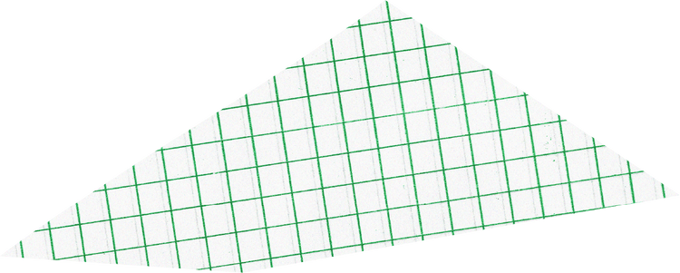






FLASK APPLICATION
Analysis Document
Prepared by
Revelli Ramana

Slide 2







APPLICATION INTRODUCTION
The Flask application is designed to add and display notes. It uses HTML templates to render the user interface and Python functions to handle the backend operations.

Slide 3

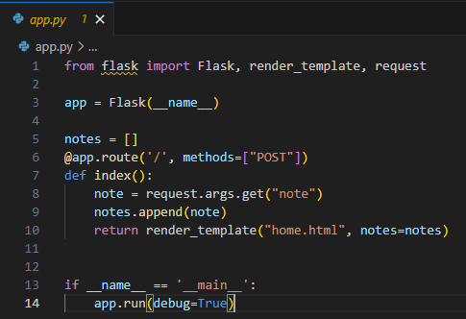
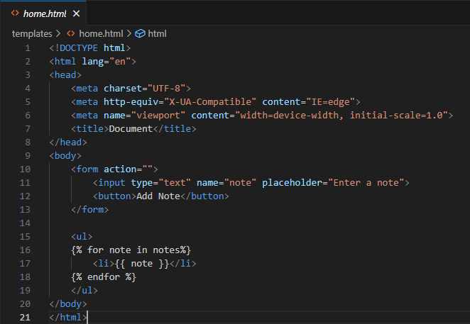

EVALUATION OF CODE LOGIC

Slide 4


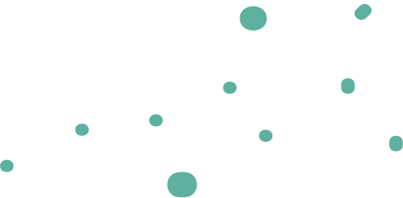
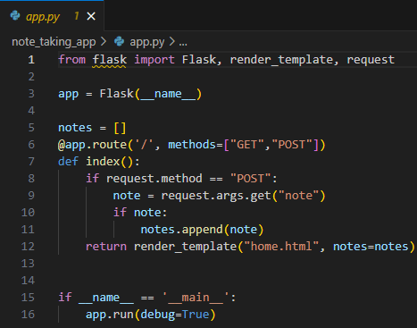
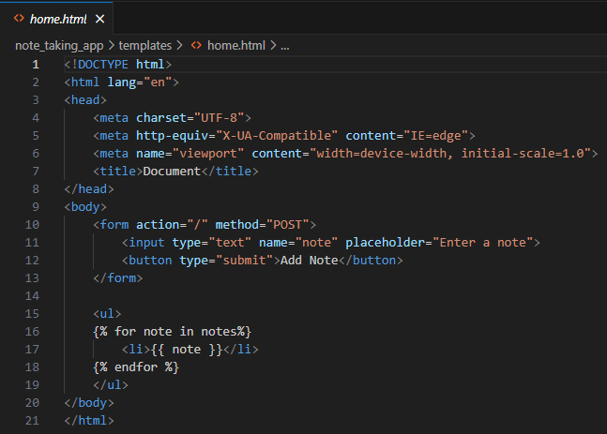
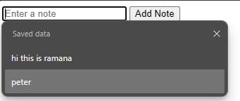
Refactoring the existing code
OUTPUT:

Slide 5



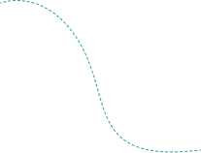

INSIGHTS
Updated the route method to handle both GET and POST requests.
Changed the submit button type to "submit" in the HTML form.
The if statement in the index function of the Flask app is used to differentiate between two HTTP methods: GET and POST.
GET request: When you initially visit the page by entering the URL in the browser or clicking a link, it sends a GET request. In this case, the index function checks if the request method is GET and renders the template with the existing notes.
POST request: When you submit the form (by clicking the "Add Note" button), it sends a POST request to the server. The index function checks if the request method is POST and then retrieves the note from the form data using request.form.get("note"). If a note is present, it adds it to the notes list.

